Slide 1
Reading Group 20/03/2024
Md Musfiqur Rahman, Murat Kocaoglu (2024): Modular Learning of Deep Causal Generative Models for High-dimensional Causal Inference

Slide 2
Introduction

Slide 3
Background - Structural Causal Model
An SCM $M$ is a $5$-tuple $M=\left(V,N,U,F,P\left(.\right)\right)$
Each observed variable $V_{i}∈V$ is realized as an evaluation of the function $f_{i}∈F$ looks at a subset of the remaining observed variables
  Remaining observed variables $Pa_{i}⊂V$ (Parent Set of $V_{i}$)
  Unobserved exogenous noise variable $E_{i}∈N$
  Unobserved confounding variable $U_{i}∈U$
$P\left(.\right)$ is a product joint distribution over all unobserved variables $N∪U$

Slide 4
Background - SCMs and Causal Graphs
Each SCM induces a directed graph called the causal graph or acyclic directed mixed graph (ADMG)
In the context of this paper, the graph is still acyclic, but no longer a DAG
  The graph can handle bidirectional edges (e.g. $V_{i}↔V_{j}$) to represent unobserved confounders
$V_{i}$ is called an ancestor of $V_{j}$ if there is a directed path from $V_{i}$ to $V_{j}$
A subset $g⊂G$ is called a c-component if it is a maximal set of nodes in $G$ that are connected by bi-directed paths

Slide 5
Introduction
Goal: Perform Causal Inference, e.g. evaluating the causal effect of an intervention on a system of interest
Today, most of our datasets contain high-dimensional variables, such as images
Modern deep learning architectures can handle high dimensional data and solve ML problems such as prediction or learning distributions
However, they are not designed to perform causal inference
  They fail to generalize where there exists spurious correlations in the data

Slide 6
Main Example of the paper
Healthcare dataset with Symptoms, Diagnosis and XrayImages of a collection of patients
  Contains a mixture data from two hospitals in different cities where one of the cities is more wealthy, where patients are less likely to fall sick on average
Hospital location acts as a latent confounder that affect both the Symptoms and Diagnosis

Slide 7
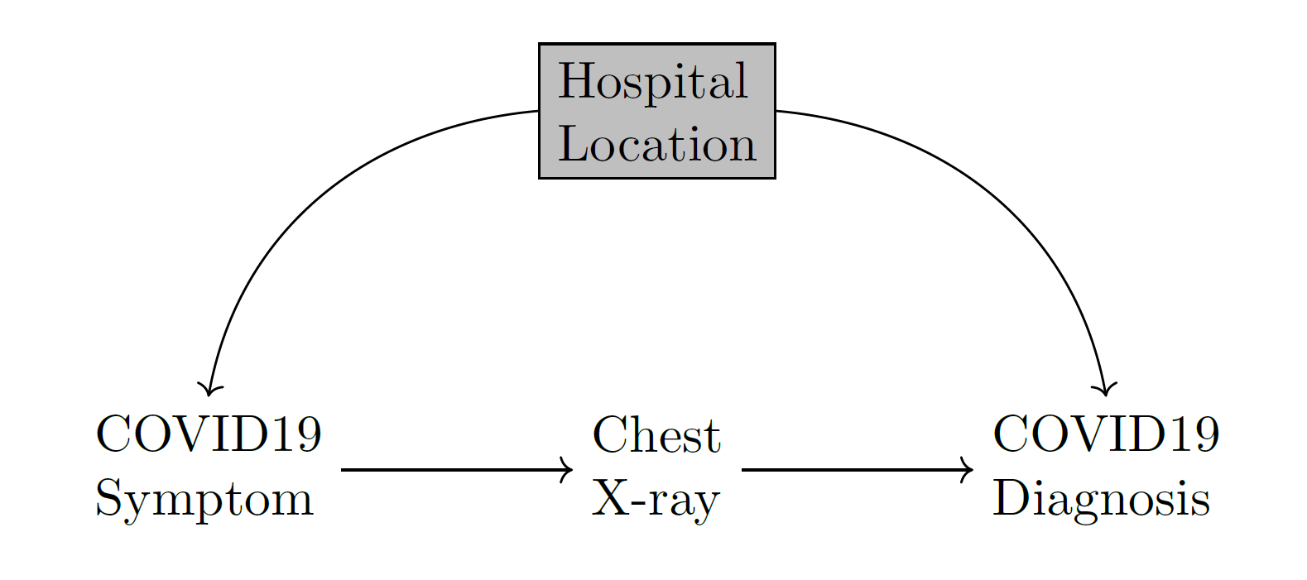
Main Example of the paper
Causal Graph of the main example

Slide 8
Main Idea of the paper
The paper proposes a modular sampling-based framework for deep causal generative models
  Collect observational samples and use these samples to estimate the interventional distribution
In this paper, $L_{1}$, $L_{2}$, and $L_{3}$ distributions as notation for observational, interventional, and counterfactual distributions respectively
Using deep learning architectures that mimic the causal structure of the system
Using pre-trained generative models like DALL-E, ChatGPT or Bard

Slide 9
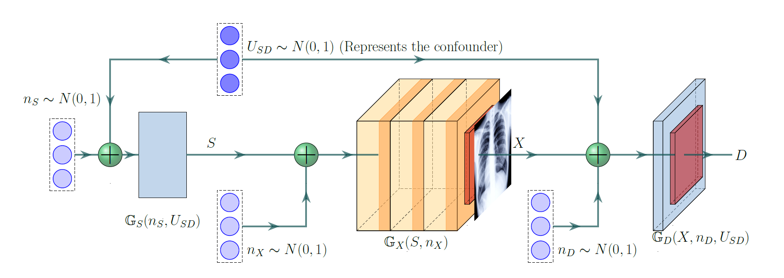
Main Idea of the paper
Deep Causal Generative Model

Slide 10
Deep Causal Generative Models with Unobserved Confounders

Slide 11
Definition
Let a SCM $M$ be made up of functions $X_{i}=f_{i}\left(Pa_{i},E_{i}\right)$.
A neural net architecture $G$ is called a deep causal generative model (DCM) for an ADMG $G$ inducing a distribution $Q$ if it is composed of a collection of neural nets, one $G_{i}$ for each $V_{i}∈V$ such that
Each $G_{i}$ accepts a sufficiently high-dimensional noise vector $N_{i}$
The output of $G_{j}$ is input to $G_{i}⇔V_{j}∈Pa_{G}\left(V_{i}\right)$
$N_{i}=N_{j}⇔V_{i}↔V_{j}$
Note that $G$ will contain one neural net per observed variable: $G=\{G_{Z_{1}},G_{Z_{2}},...\}$

Slide 12
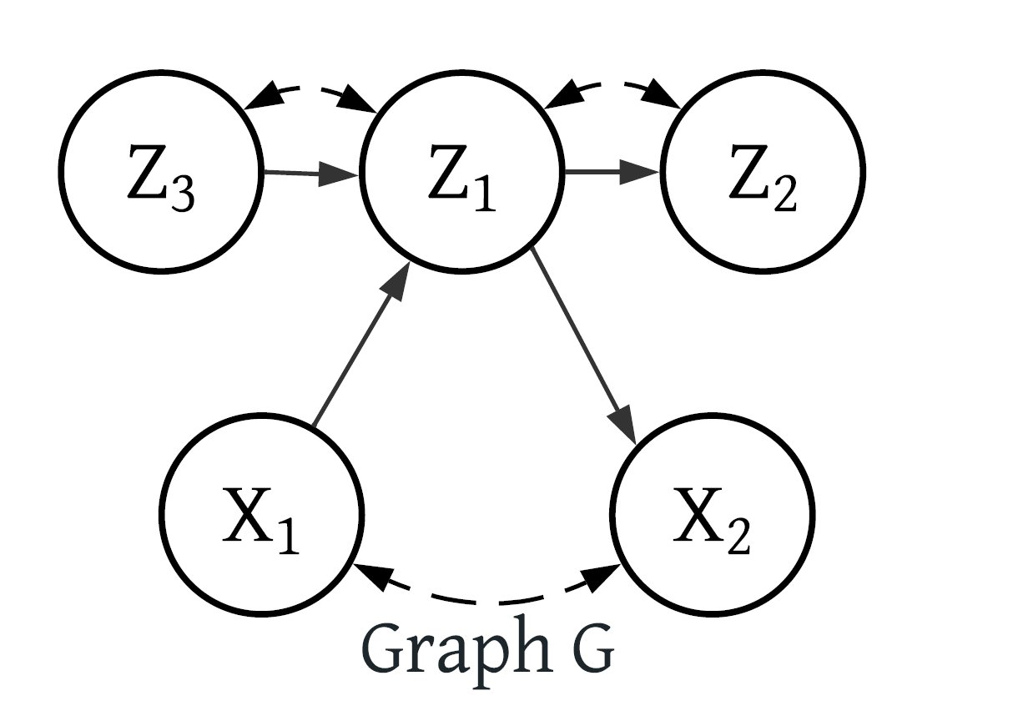
Intuition
Let $D∼P\left(V\right)$ be an observational sample
Train a DCM $G$ that fits the observational distribution $P\left(V\right)$ to sample the interventional distribution $L_{2}$
Training involves identifying which causal mechanisms should be trained together based on their dependencies in the causal graph
Start with the first neural network $G_{Z_{1}}∈G$ to learn a mapping to sample $P\left(Z_{1}|Z_{3},X_{1}\right)$
The training preserve the integrity of c-components and factorize the joint distribution of them to yield $P\left(V\right)$
Example Causal Graph: $X$ denotes the first c-component, $Z$ the second c-component

Slide 13
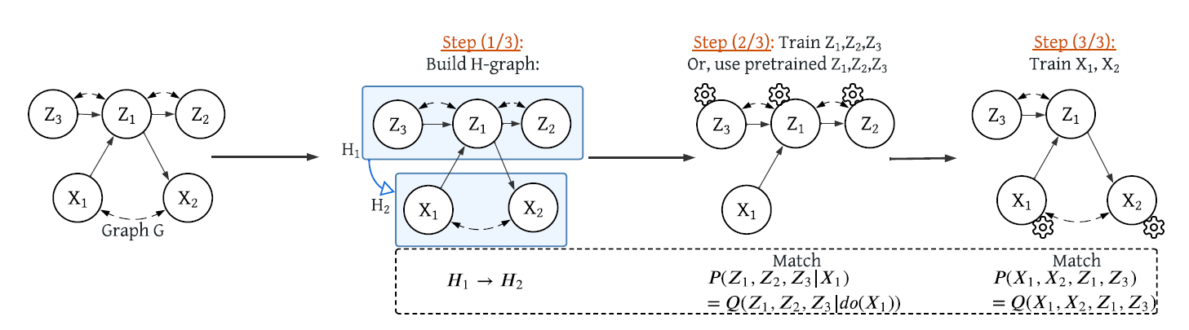
Intuition
Modular training in 3 steps. Step 1: Since $P\left(X_{1},X_{2}|do\left(Z_{1}\right)\right)≠P\left(X_{1},X_{2}|Z_{1}\right)$, add an edge from c-component $H_{1}:\left[Z_{1},Z_{2},Z_{3}\right]$ to c-component $H_{2}:\left[X_{1},X_{2}\right]$. Step 2: Train only the mechanisms in $H_{1}$ to match $P\left(Z_{1},Z_{2},Z_{3}|X_{1}\right)=Q\left(Z_{1},Z_{2},Z_{3}|do\left(X_{1}\right)\right)$. Step 3: Train only $H_{2}$ while using pre-trained $Z_{1},Z_{3}$ to match $P\left(X_{1},X_{2},Z_{1},Z_{3}\right)=Q\left(X_{1},X_{2},Z_{1},Z_{3}\right)$

Slide 14
Intuition
By training mechanisms in the same c-component together, the complexity of matching joint distributions involving high and low-dimensional variables is significantly reduced.
Modularizing the training process allows for more efficient training and simplifies the overall learning task.

Slide 15
Experiments

Slide 16
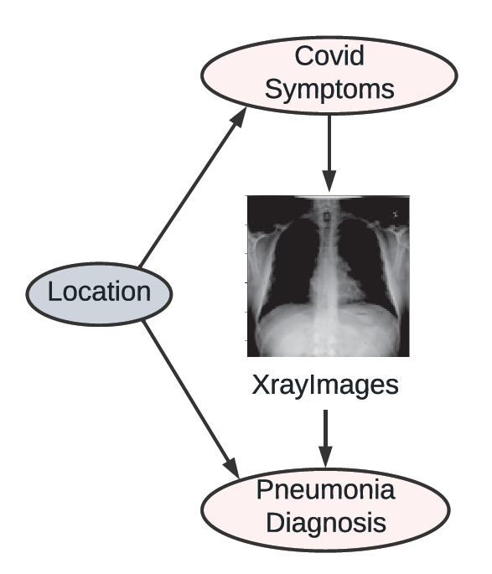
Performance on Real-world COVIDx CXR-3
$30000$ XRay images with labels $C$ (Covid) and $N$ (Pneumonia)
  Healthy patiens: $C=0,N=0$
  Non-Covid Pneumonia patiens: $C=0,N=1$
  Covid Pneumonia patiens: $C=1,N=1$
Patient’s location is a hidden confounder
  A persons socio-economic and health conditions in a specific location might affect both the likelihood of getting Covid and being properly diagnosed with Pneumonia by local health care
COVIDx CXR-3 graph

Slide 17
Performance on Real-world COVIDx CXR-3
Fit the joint distribution $P\left(XRay,C,N\right)$
Modular training of $\left[G_{Xray}\right]→\left[G_{C},G_{N}\right]$
  Using pre-trained generative model for X-Ray images $G_{Xray}$
  Train $G_{C}$ and $G_{N}$ together as they are in the same c-component
The joint distribution contains both low and high-dimensional variables
  Map $Xray$ to a low-dimensional representation $Rxray$ with an encoder and match $P\left(C,Rxray,N\right)$

Slide 18
Performance on Real-world COVIDx CXR-3
The score which is minimized is the Total Variation Distance (TVD)
The average treatment effect, i.e., the difference between $E\left[P\left(N|do\left(C=1\right)\right)\right]$ and $E\left[P\left(N|do\left(C=0\right)\right)\right]$ is in $\left[0.05,0.08\right]$
  Intervention with Covid increases the likelihood of being diagnosed with Pneumonia

Slide 19
Conclusion

Slide 20
Conclusion
The paper propose Modular-DCM for learning deep causal generative models for estimating causal effects with high-dimensional variables in the presence of unobserved confounders
Modular-DCM can generate high-dimensional samples from identifiable interventional and counterfactual distributions
Main Limitation: The paper assumes that the causal graph is fully specified with latents and the causal model is semi-Markovian (the probability of there being a change in the hidden state depends on the amount of time that has elapsed since entry into the current state (?))

